Slide 1



KBC GAME
Prepared By Inderjeet Singh
Roll no:143
Batch:B5
Branch:CSE

Slide 2
PROJECT OUTLINE
Introduction
System Design
Flow Diagram
Java Implementation
Game Play Flow

Slide 3
Introduction
Title: Kaun Banega Crorepati - Java Game.
Subtitle: A Java Based Solution For Playing KBC Game.
Brief Overview:
This Game includes 4 questions and 3 LifeLine will be provided to each player. Price Money will be given on every correct answere,and if the answere is wrong than player will lose the game and the price money it has won.
This Game is Created For Entertaining Purpose.

Slide 4
System Design
Title: Game Architecture.
Subtitle: The game follows the format of the popular TV show "Kaun Banega Crorepati“.
Diagram or Flowchart.
Shows the interaction between the program and player.
Explain the flow of asking questions ,answering questions, taking lifeline, adding Price Money, checking answere in game.

Slide 5
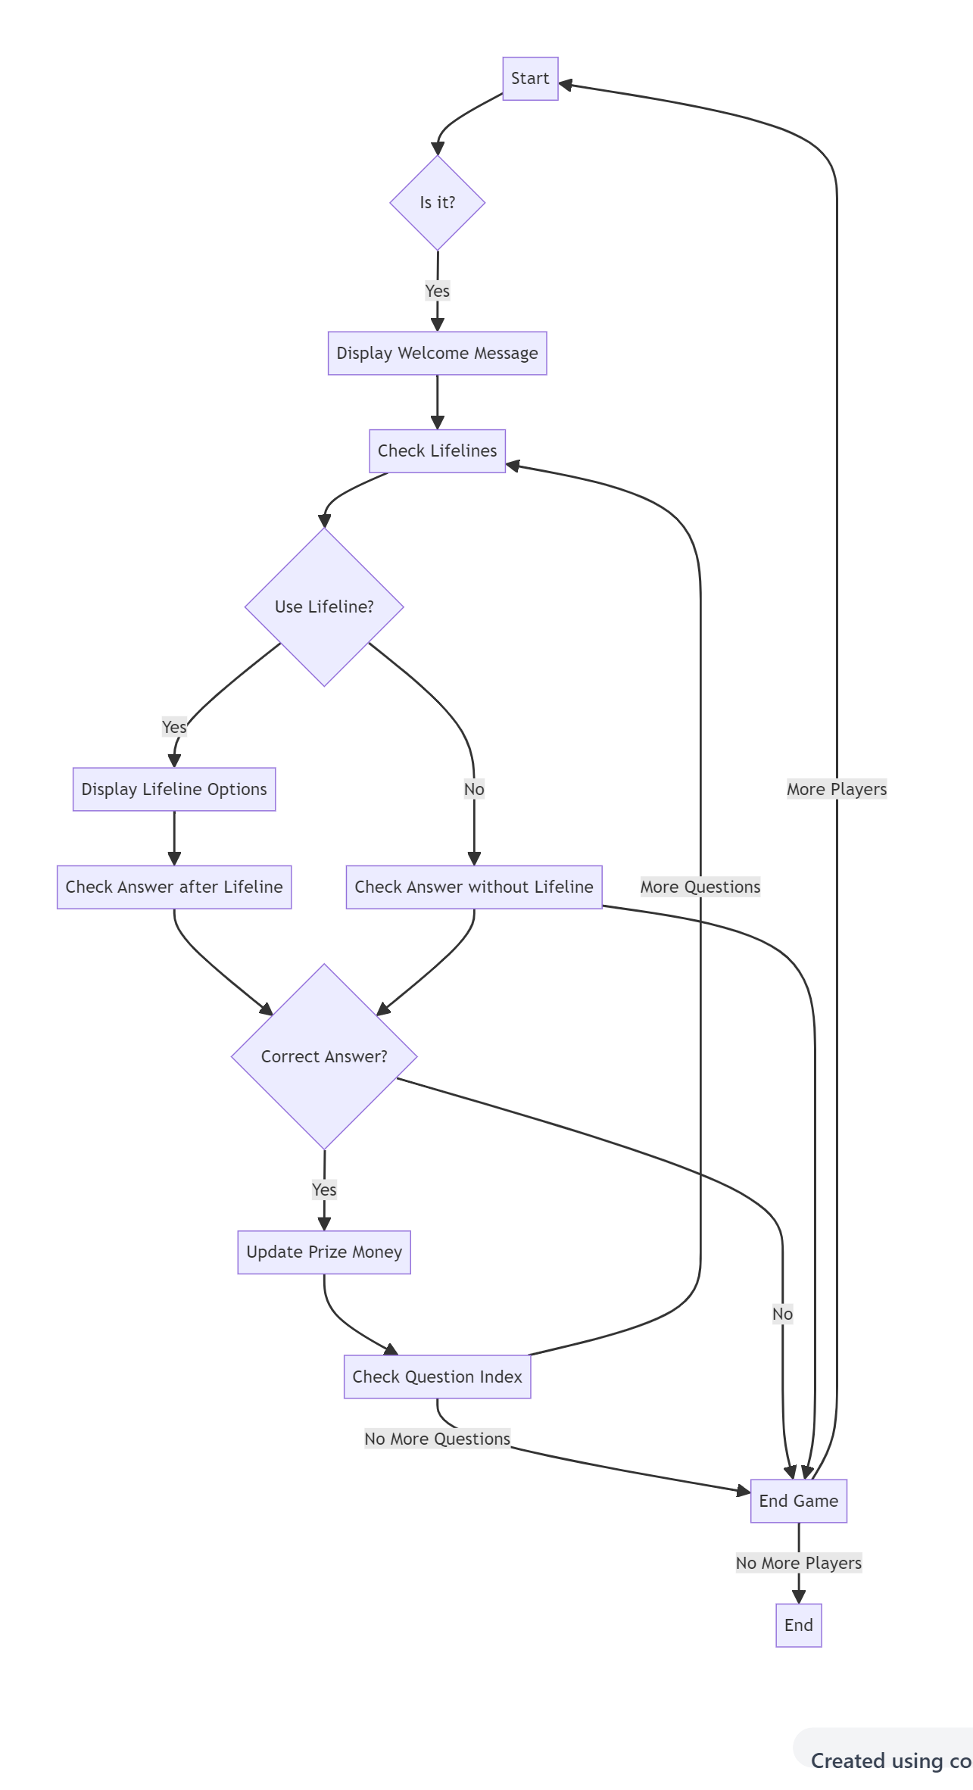
Flow Diagram

Slide 6
JAVA IMPLEMENTATION
The Game is implemented in java Language.
Explains the Topic used in the Game.
The Topics Used are if-else, loops, Arrays, Strings, Multiple classes, types of Methods and lastly array of object for multiple players.

Slide 7
Gameplay flow
Displaying questions and options.
Offering lifelines (50-50).
Taking user input for answers.
Calculating prize money.

Slide 8
Thank you

